Slide 1
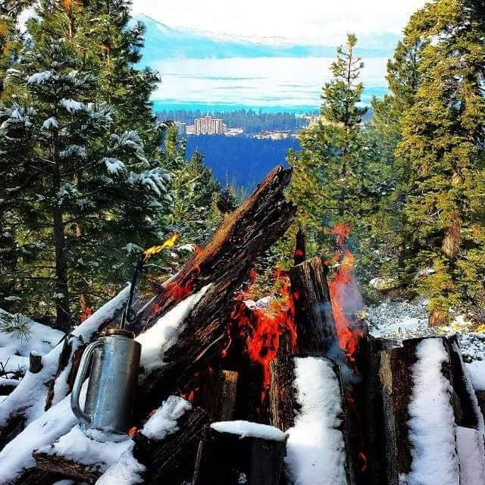
Tahoe Rx Fire
Tahoe
Rx Fire

Slide 2
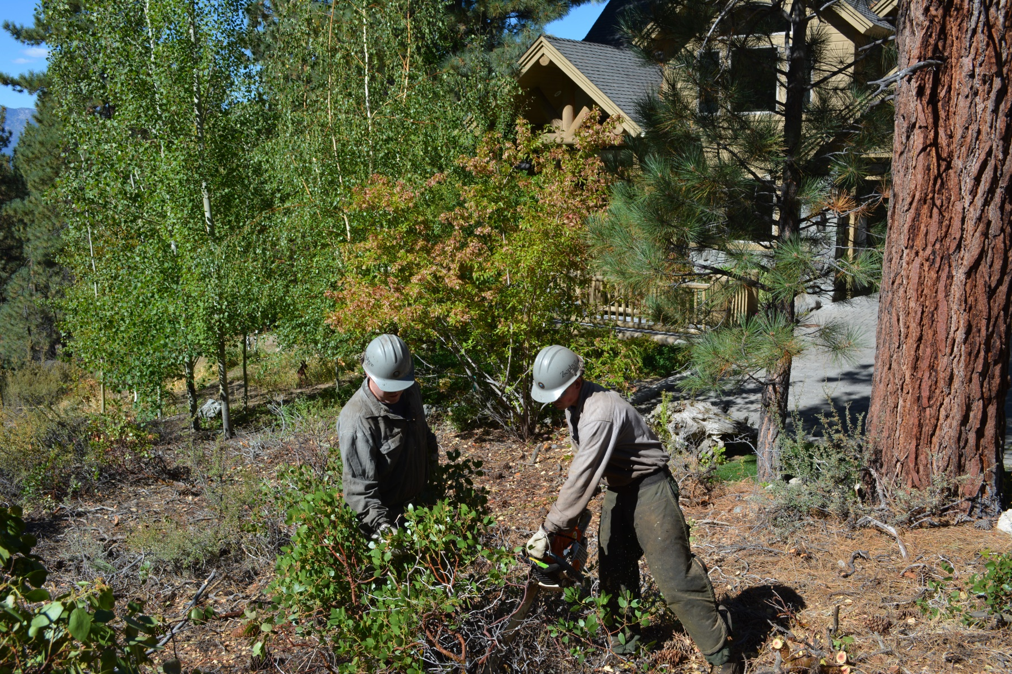
Hand Thin/Piles

Slide 3
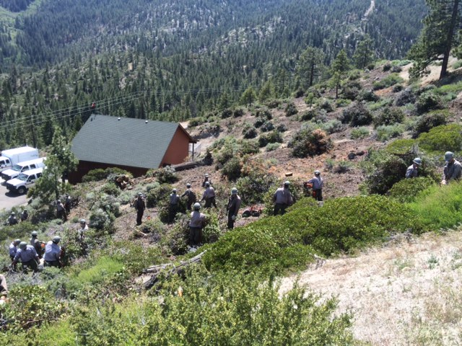
Hand Thin/ Piles

Slide 4
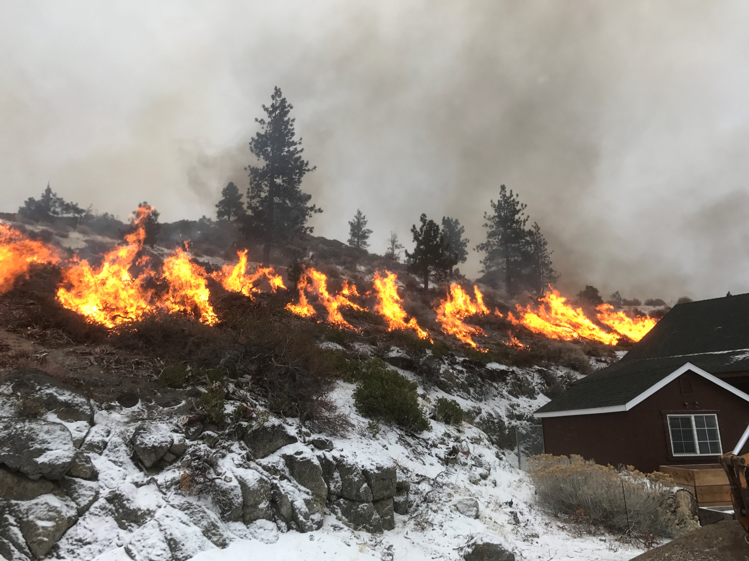
FIRE Hill image

Slide 5
Pile Burning

Slide 6
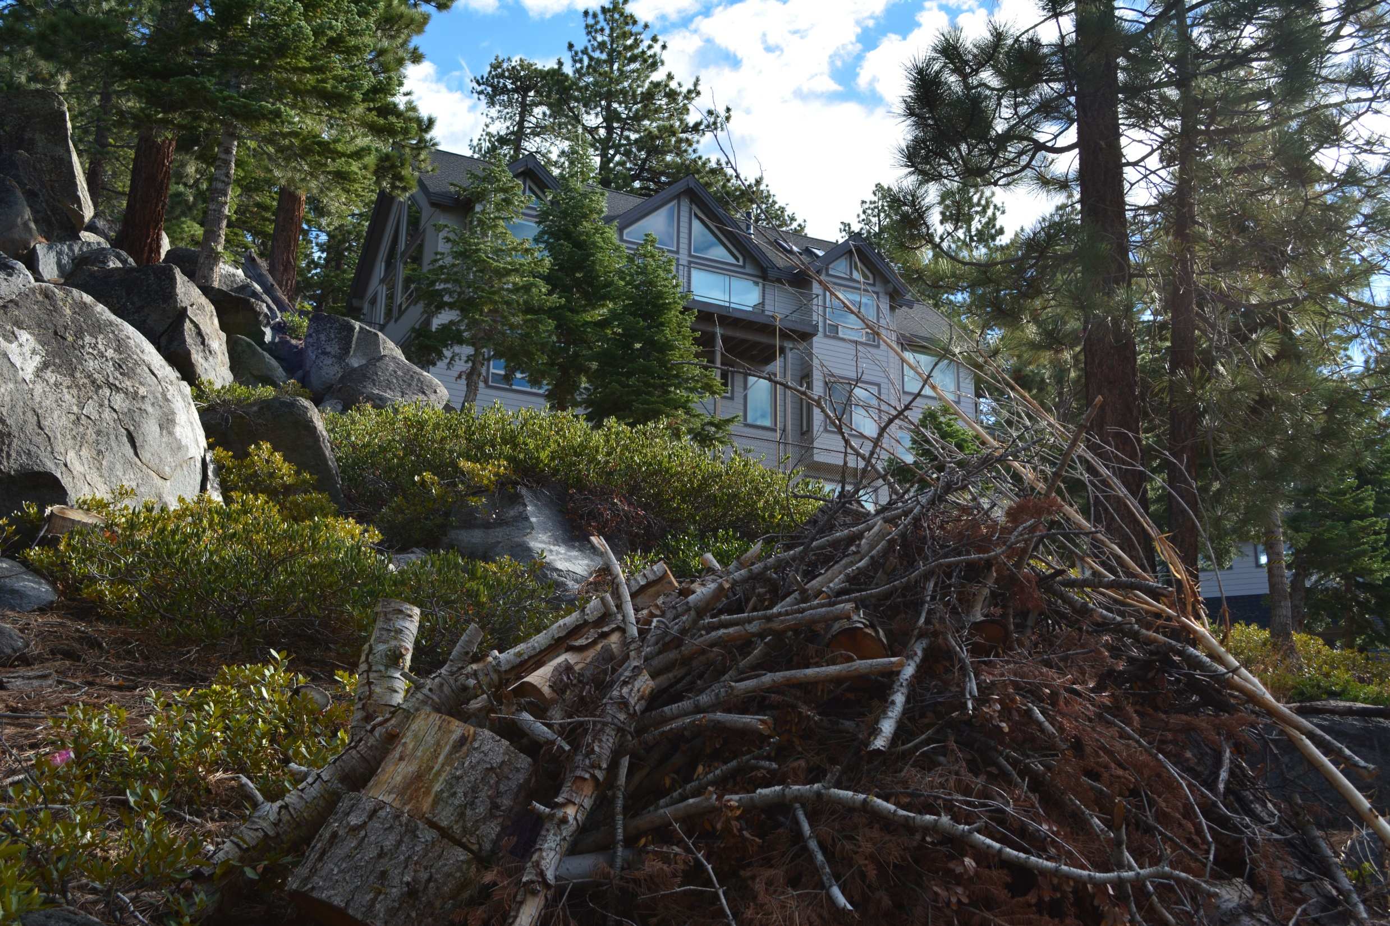
Conditions…
Conditions…

Slide 7
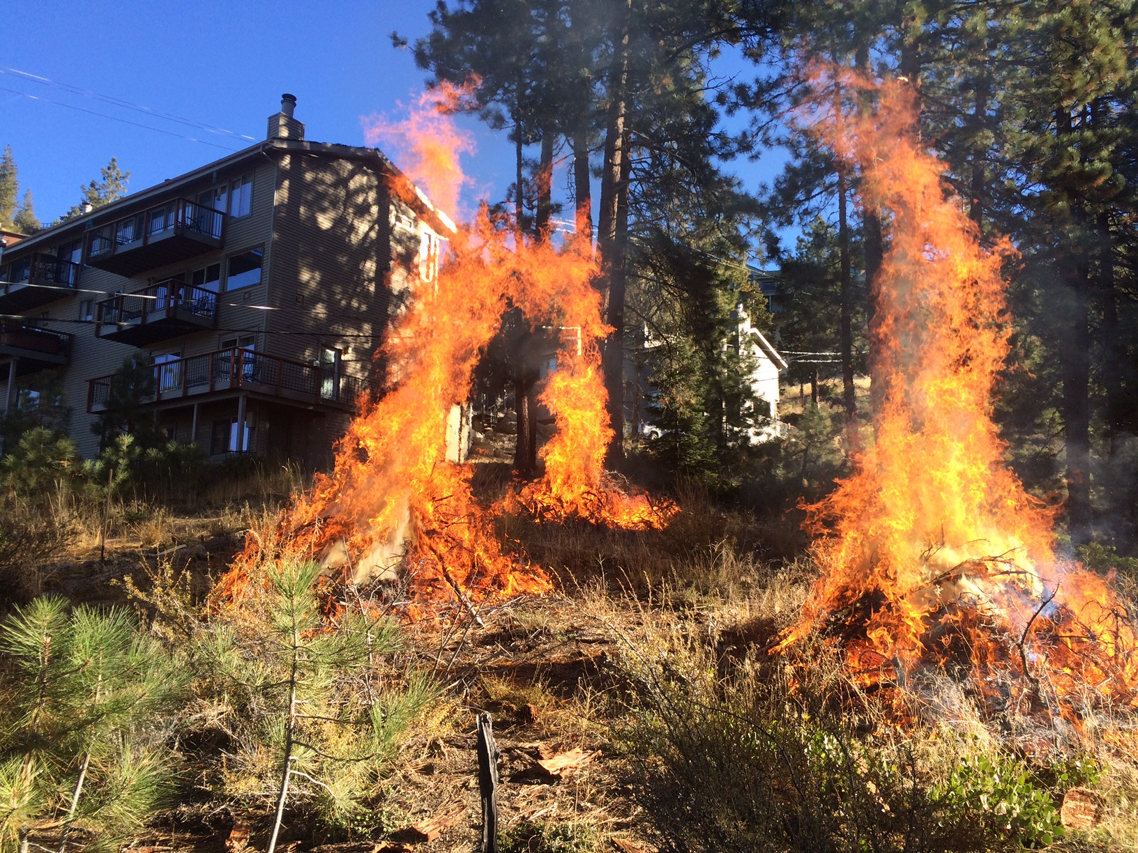
3 Fire Image

Slide 8
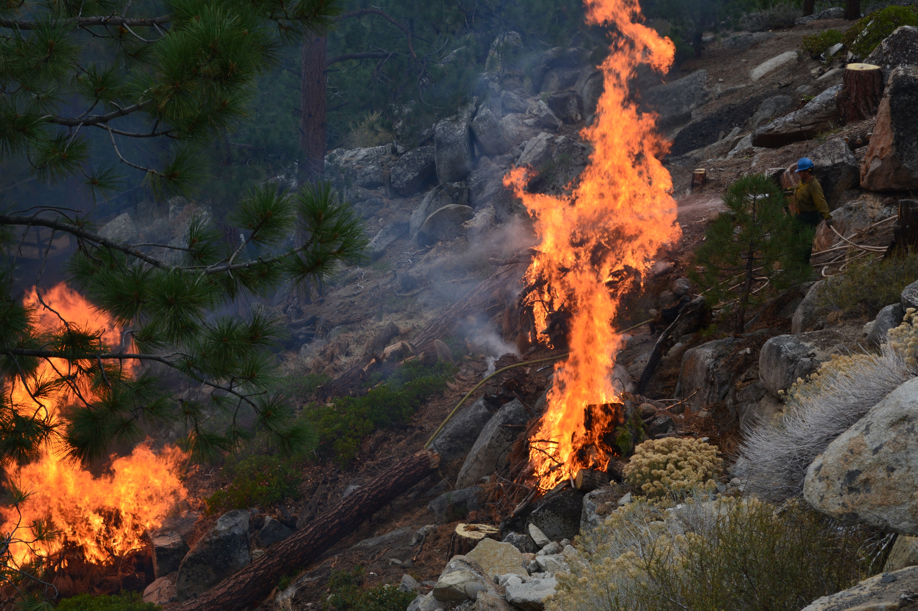
Rock Fire Image

Slide 9
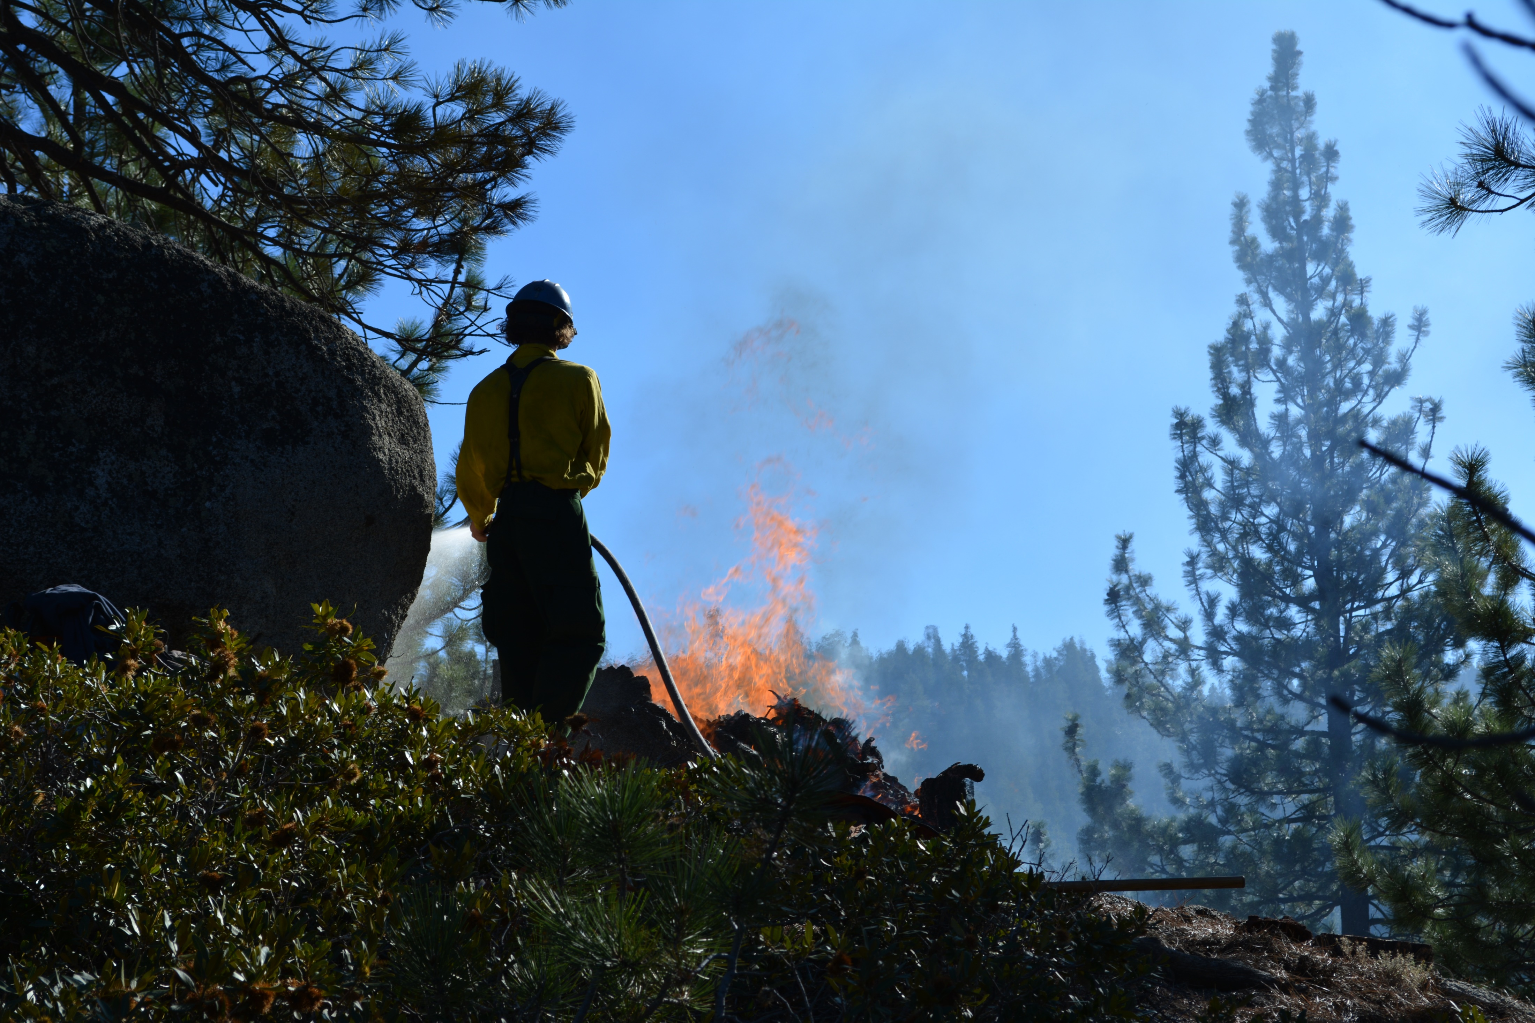
Firefighter Image

Slide 10
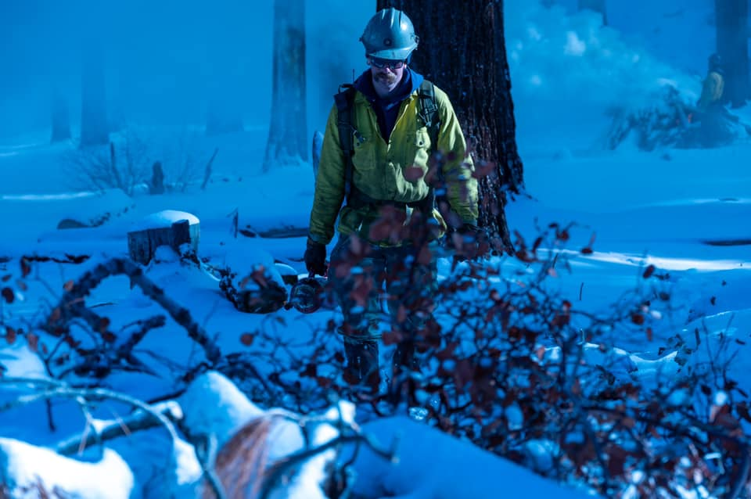
Firefighter Snow Image

Slide 11
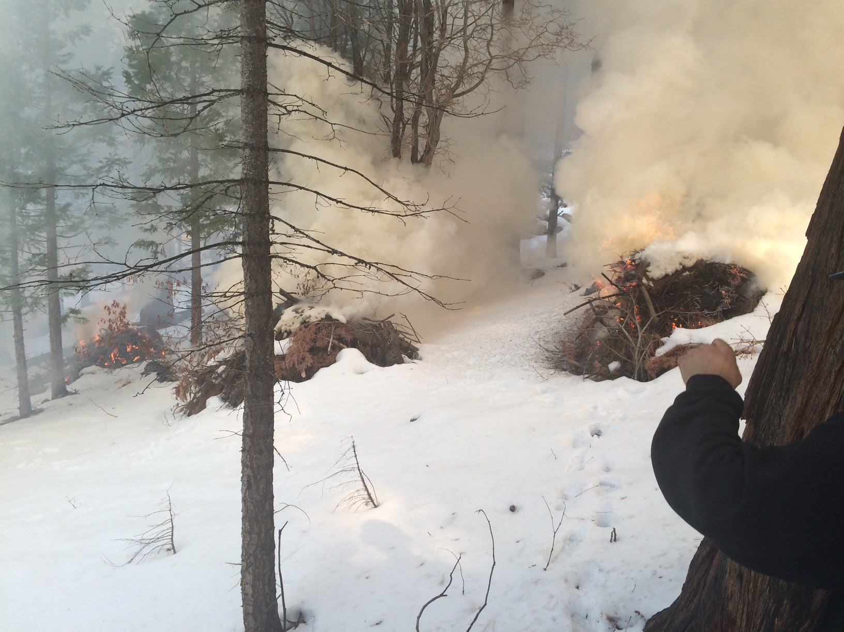
Snow Fire Image

Slide 12
Obstacles

Slide 13
Highway Crash Image

Slide 14
Snow Pile Image

Slide 15
Questions?

