Slide 1
LIVING WITH FIRE 2021
Evacuations
Jason Danen
Deputy Emergency Manager
Carson City Fire Department

Slide 2
REGISTER TO RECEIVE EVACUATION NOTICES & Fire Information
In an emergency, officials may use many different tools to communicate information and instructions to the community:
CODERED

Slide 3
What is Code Red
Carson City has instituted the CodeRED Emergency Notification System - an ultra-high-speed telephone communication service for emergency notifications. This system allows us to telephone all or targeted areas of the City in case of an emergency situation that requires immediate action (such as a boil-water notice, missing child or evacuation notices). The system is capable of dialing 50,000 phone numbers per hour. It then delivers our recorded message to a live person or an answering machine, making three attempts to connect to any number.

Slide 4
What is Code Red Continued
THIS SYSTEM WILL ONLY BE USED FOR EMERGENCY PURPOSES
Examples of times when the CodeRED system could be utilized: drinking water contamination, utility outage, evacuation notice and route, missing person, fires or floods, bomb threat, hostage situation, chemical spill or Gas leak, and other emergency incidents where rapid and accurate notification is essential for life safety.

Slide 5
How to sign up
carson.org

Slide 6
Other Methods of Communication
Reverse 911
Social Media,
local TV
Ring neighbors
Twitter
Radio
Carson Now

Slide 7
Sign up and prepare to use these systems now.
Sign up and prepare to use these systems now.
These systems are not guaranteed to work in an emergency or during a power outage, and monitoring and understanding them is your personal responsibility. To ensure that you have access to information from multiple sources in an emergency.
Monitor a battery powered AM/FM radio continuously during power outages to keep apprised of current conditions.
Don't neglect to use your own senses - look, listen, and smell for signs of fire and changing conditions!

Slide 8
Evacuation Terminology
Evacuation Terminology
The terms “voluntary” and “mandatory” are often incorrectly used to describe evacuations. In Northern Nevada, fire agencies and law enforcement will use the terms Evacuation Order, Evacuation Warning, and Shelter-In-Place to alert you to the significance of the danger and provide basic instructions. All evacuation instructions provided by officials should be followed immediately for your safety.

Slide 9
Evacuation Order
EVACUATION ORDER
Leave now! Evacuate immediately, do not delay to gather belongings or prepare your home. Follow any directions provided in the evacuation order.

Slide 10
Evacuation Warning
EVACUATION WARNING
Evacuate as soon as possible. A short delay to gather valuables and prepare your home may be ok (see Evacuation Checklist) may be ok. Leave if you feel unsafe.

Slide 11
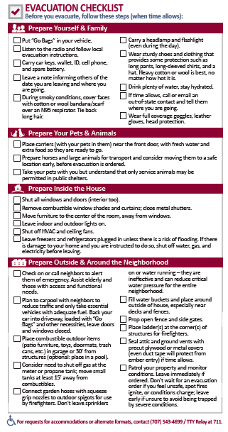
Evacuation Checklist

Slide 12
Shelter in Place
SHELTER IN PLACE
Stay in your current location or the safest nearby building or unburnable area. May be required when evacuation isn’t necessary or is too dangerous.

Slide 13
Before a Fire Threatens
Before a Fire Threatens
Review Your Evacuation Checklist
Have a evacuation Checklist and Family Communication Plan! Print a copy for every family member and fill out in advance.
Assemble a Wildfire and Emergency "Go Kit"
At all times during fire season, prepare a Wildfire and Emergency "Go Kit." Assemble a kit for each family member and pet, and keep the kit(s) in your vehicle or near your front door.

Slide 14
When Evacuation is a Possibility
When Evacuation is a Possibility
Monitor information sources - AM/FM radio, cell phone and home phone, social media and TV, and look, listen and smell for changes outside.
Dress for survival (see below).
Complete your evacuation checklist if time allows.
Locate your Go kit and place the items in your vehicle.
Park your vehicle facing outward and carry your car keys with you.
Place your pets in crates or carriers BEFORE evacuation is ordered and keep them nearby.
Prepare large animals for transport.
Patrol your property and monitor the fire situation.
Evacuate immediately if you feel threatened. Do not wait for an evacuation order.

Slide 15
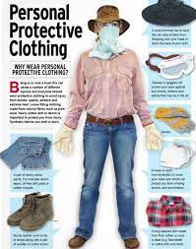
Dress for Survival
Dress For Survival
When preparing to evacuate, dress yourself and family in clothes that will shield from heat, embers and flames. Natural fabrics, such as heavy denim or pure wool are better than synthetics, no matter how hot it is. Keep these items near your “Go Kit” during fire season:
Sturdy leather boots with Vibram-lug soles
Long pants (wool or cotton) with sturdy belt
Floppy cotton hat
Handkerchief or bandana to cover face
Full-coverage goggles
Long sleeved shirt that covers neck (tuck into pants)
Wool socks
Leather work gloves
Put these clothes on at the first sign of trouble. If you can smell or see smoke, it’s time to prepare.

Slide 16
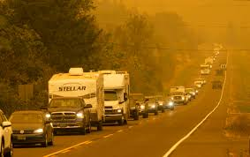
The Evacuation Process
The Evacuation Process
Fire officials will determine the areas to be evacuated and the routes to use depending upon the fire’s location, behavior, winds, terrain, etc. Law enforcement agencies are responsible for enforcing an evacuation order. Follow their directions or the directions of firefighters promptly.
When time allows, emergency managers will attempt to advise you of potential evacuations as early as possible. You must take the initiative to stay informed and aware. There is no guarantee that you will receive notification of an evacuation order (for example, if the fire spreads too rapidly to allow for notification, if a power failure or the fire itself disables communication infrastructure, if your phone battery is dead or if you failed to "opt-in" to emergency alerts). Listen to your radio or TV for announcements from law enforcement and emergency personnel.
Be sure to have signed up for the alert system BEFORE a fire threatens you.
You may be directed to temporary assembly areas to await transfer to a safe location. Evacuate to the nearest major community AWAY from the fire.

Slide 17
When to Evacuate
WHEN TO EVACUATE
Leave immediately if you receive a notification or alert to avoid being caught in fire, smoke or road congestion. Don’t wait to be ordered by authorities to leave if you are unsure, feel threatened, or lose power or communications. Law enforcement will direct the evacuation, and they will keep intersections open and moving, but their resources may be limited. Evacuating early (before evacuation is ordered) helps keep roads clear of congestion, and lets fire apparatus move more freely to do their job. If you are advised to leave, don’t hesitate!
The fire Incident Commander will issue the evacuation order through the Sheriff's Office, and will determine the areas to be evacuated and escape routes to use (if there are options) depending upon the fire’s location, behavior, winds, terrain, etc.
Law enforcement agencies are responsible for enforcing an evacuation order. Follow their directions promptly.
You will be advised of potential evacuations as early as possible.
You must take the initiative to stay informed and aware. Listen to your radio (AM 1610, AM 840, and others) and TV for announcements from law enforcement and emergency personnel.
You may be directed to temporary assembly areas to await transfer to a safe location.
All evacuation instructions provided by officials should be followed immediately for your safety.

Slide 18
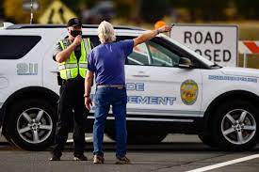
Evacuation Routes
Evacuation Routes
Take the shortest route An Evacuation Route Map with at least two routes (if possible).*
Drive your planned route of escape before an actual emergency. This is most likely the route you normally take to leave your community, as that's typically the shortest and is the route you're most familiar with.
The darkness and flames of a fire can be disorienting. Familiar landmarks may not be recognizable.
*During an evacuation, law enforcement or emergency personnel may direct you to an alternate route. Always follow their directions

Slide 19
Install Battery Backups for Garage and Communications
Install BATTERY BACKUPS FOR GARAGE DOORS AND COMMUNICATIONS
It's very common for the power to go out before a fire strikes, since fire and winds can damage electrical infrastructure. You need to be prepared to communicate and escape, even without power. How will you receive warning at night if the power is out, and how will you open your garage door to evacuate if there is no power?
For garage doors, a battery backup should be installed. They typically cost less than $100, and can be installed by homeowners.
Check with your garage door opener manufacturer to see if they make a battery specific to your opener model, although universal models are available.

Slide 20
Use a Uninterruptible Power Supply
For home phones and internet connections, a "UPS" Uninterruptible Power Supply is a good option (link is for Amazon, however they are available locally, in-stock at Best Buy, Costco, and other electronics stores).
The larger the UPS is, the longer it will last when the power goes out (consider the 1500VA model, about $150). Consider keeping one dedicated to your home phone, and another dedicated to your internet cable modem. A 1500VA model will last about 2 hours when attached to a cable modem and router, and a home phone may last up to 24 hours, depending on usage.
Please consult with the manufacturer for specifics and installation instructions. Test regularly to confirm function.

Slide 21
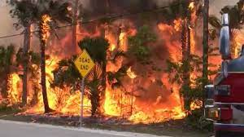
What if there is traffic or my road is blocked?
WHAT IF there is traffic or MY ROAD IS BLOCKED?
Don't panic! Law enforcement can move a large number of vehicles through intersections. Remember that your car provides a tremendous amount of protection from heat, smoke, and embers.
Stay calm.
Don't abandon your car in the roadway or where it will impede the evacuation of others.
Being stuck in traffic in your car, on unburnable pavement, is almost always safer than being exposed on foot.
Drive calmly and safely.
Visibility will be low, proceed carefully.
Turn your lights on.
The presence of fire or flames on the roadside does not necessarily mean your road is blocked. You can usually safely drive when there is fire burning on the roadsides.

Slide 22
What if there is traffic or my road is blocked? Continued…
If the road is blocked, try to clear the obstruction (if it's safe to exit your vehicle).
If an alternate route is available and your main route is blocked, take it.
Try to drive away from the fire if possible, and take the shortest route to a valley floor if you're on a hillside.
Do not leave your vehicle unless there is no other option or your car is on fire. Leaving your car is a last resort and may prove deadly. You are almost always safer in your car or a building.
Do not abandon your car in the roadway. Park it off the road if there is no other option.
Take refuge in an open area like a ballfield, large parking lot, or shelter inside a building if no quick escape route is available.
If you must shelter indoors, close doors and windows, stay low (lay on the floor, crawl to move if there is smoke or heat in the building), and stay near a door. Stay inside until the fire passes or conditions become untenable.

Slide 23
My Neighborhood is one way in, one way out!
MY NEIGHBORHOOD IS ONE WAY IN, ONE WAY OUT!
If you live in a "one way in, one way out" neighborhood, as is common in Marin, your escape route is predetermined.
Use the "one-way-out" direction and leave! Drive towards your neighborhood's exit, and to the nearest town away from the fire.
Follow instructions in the alert messages if they provide evacuation shelter or escape route information.
Do not attempt to evacuate by fire roads or open spaces where you might be exposed to burning vegetation. Fire roads are almost always more dangerous than being in your car on the pavement.
But fire engines will block my escape!
When evacuation has been ordered, the fire's Incident Commander will instruct fire engines not to enter areas where evacuation is occurring and two-way passage is not possible. Evacuation is the number one priority for firefighters.

Slide 24
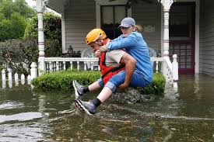
If you are unable to evacuate on your own
If you Are Unable to Evacuate on your own
Ask a neighbor to assist you or give you a ride. Pre-plan a list of neighbors who may be able to assist you.
Call 911 if you are disabled or need assistance to evacuate.
If first responders are in your neighborhood, attempt to notify them that you require assistance.

Slide 25
Fire Roads
Fire Roads
Fire roads (or other unpaved or locked roads leading to open spaces) are NEVER safe or viable evacuation routes during wildfires! Stay on pavement and evacuate towards major roads and away from the fire, unless instructed otherwise by emergency personnel.
Even if your evacuation route is blocked, you're almost always better off remaining in your car or taking shelter in a house until the fire passes. Walking into unburned, open areas surrounded by vegetation is the MOST DANGEROUS THING YOU CAN DO during a wildfire.
During wildfires, always follow the instructions of law enforcement officers or firefighters.
Unless instructed otherwise, you should ALWAYS plan to evacuate downhill towards major roads and away from the fire.

Slide 26
If you become trapped
If You Become Trapped
Wildfires are unpredictable and spread quickly. Even if you’ve prepared in advance, you may be required to “shelter in place” if ordered or if you find yourself trapped by a wildfire. To survive this frightening scenario, it is important to remain calm and keep everyone together. Prepare yourself mentally for darkness (even during the day), noise, chaos, and the natural urge to flee the safety of your shelter. If you’re unable to evacuate, it’s probably safer INSIDE a car or building where your airway, eyes, and skin are protected!
Take shelter in the nearby place that is best able to withstand the fire. This may be your home, another building made of more resistant materials or that is less exposed to burning vegetation, your car, or an open outdoor area like an irrigated playing field or parking lot far from vegetation. Stay calm and together while the wildfire passes. When directed, or when the fire outside subsides, move to a safer area.
If safe evacuation is not an option, follow these steps:

Slide 27
Shelter in a House or Building
Shelter in a House or Building
A building should be your first choice for shelter if evacuation is not possible.
Close all doors and windows and leave them unlocked.
Keep car keys, cell phone, ID, and flashlight with you.
Gather all family members and pets (in carriers) and lay down near the front door, protecting your airway by breathing near the floor if it becomes smoky or hot.
Monitor the fire and be observant. Watch for small (spot) fires.
Call 9-1-1 and let them know your location.
Leave the house only if it becomes too hot or smoky inside, or when it’s obviously safer outside.

Slide 28
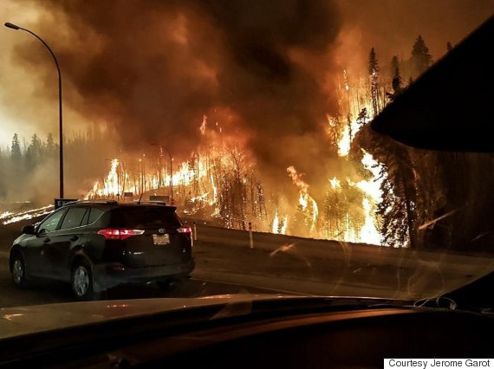
Shelter in your car
Close all windows and doors, shut off all air vents, and turn off the air conditioner.
Shelter in Your Car
If your escape route is blocked and there is no safe building nearby to take refuge in, park and stay in your car - it is far safer than being out in the open.
Never attempt to evacuate by unpaved fire-roads.
Find a place to park on pavement that has little or no vegetation, in an outside turn if on a hillside.
Turn on headlights and emergency flashers to make your car more visible through heavy smoke.
Get below the windows, under blankets (preferably wool) and lie on the floor to shelter yourself from radiant heat if it becomes hot.
Call 9-1-1 and let them know your location.
Stay in the vehicle as long as possible.
Wait until the fire front passes and temperature has dropped outside, then get out and move to a safe area that has already burned.

Slide 29
Inside the Home
INSIDE THE HOME
Keep all family members together.
Stay inside the house until the fire front passes. Although it may be very hot in the house, it may be unsurvivable outside.
Stay near an exit door, low to the floor.
Plan for the loss of power and have water stored by filling the sinks and tubs along with buckets inside your house to put out burning embers or small fires.
Have your fire extinguishers out and in convenient locations.
Shelter in a room at the opposite end of your home from where the fire is approaching; making sure you have two possible exit routes.
Close all windows and doors.
If you have an automatic garage door opener, disconnect the unit and operate the door manually. Close the garage door when evacuating (you may not be able to reopen if the manual latch has been operated. Become familiar with manual door operation BEFORE a fire strikes!).
Close metal Venetian blinds.
Remove light curtains and other easily combustible materials from windows or draw them well past the perimeter of the window. This will prevent radiant heat from catching the window coverings on fire.

Slide 30
Inside the Home continued
Move furniture away from windows and sliding glass doors to prevent radiant heat from catching the furniture on fire.
Shut off all attic fans, whole house fans, swamp coolers and interior fans to keep smoke and ash from being drawn into house.
Bring pets inside and place in pet carriers to control their movement in the house as the roar of the fire comes.
Put livestock and horses in an area where fuels have been removed or in an irrigated pasture.
Leave exterior and interior lights on for as long as you have power. This helps firefighters to find your house in the dense smoke during a fire.
Move wheeled vehicle or equipment away from structures.
Shut off natural gas and propane unless needed for running a generator.
Connect water hoses and lay them out for best use where they will not get burned during the fire front passing.
If you have a wooden fence that connects to the exterior of your home, prevent flames from spreading from the fence to your house by propping open the gate.
Move anything that can easily ignite at least 30 feet away from the exterior of your home, including patio furniture and cushions, cloth awnings, barbecues, portable propane tanks, trash cans without lids, and firewood.

Slide 31
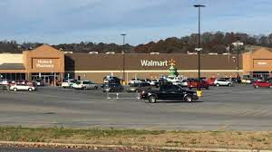
Outside the home or on foot
OUTSIDE THE HOME or On Foot
Find an area clear of vegetation, far from dry grass, brush, or trees. Ball fields, playgrounds, parking lots, golf courses, and other large open areas with pavement or irrigated, mowed lawns may provide safety for short periods.
Look for a ditch, depression, or body of water such as a pool or lake, if no open areas are nearby.
Lie face down, cover up your body. Protect your airway, by breathing close to the ground, through a dry towel or cloth. Protect your eyes.
Use your cell phone to call 911. Advise officials that you are trapped and provide your location (an address or intersection is best).

Slide 32
In your vehicle
IN YOUR VEHICLE
A structure offers more protection than a car so if there is a building nearby get inside it.
If there is no building, park and stay in your car, where it is safer than being out in the open where you could be directly exposure to flames and radiant heat.
Find a safe place to park that has little or no vegetation.
Turn on headlights and emergency flashers to make your car more visible during heavy smoke.
Close all windows and doors, shut off all air vents, and turn off the air conditioner.
Get below the windows under blankets, preferably wool, and lie on the floor to shelter yourself from the intense radiant heat.
Stay in the vehicle, as it will provide you with some insulation from the heat.
Wait until the fire front passes and temperature has dropped outside then get out and into a safe area that has already burned.

Slide 33
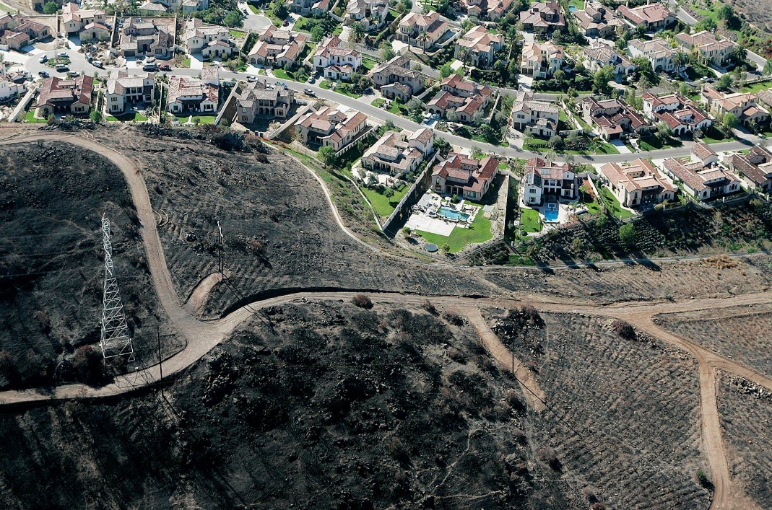
Returning Home
Returning Home
Fire officials will determine when it is safe for you to return to your home. This will be done as soon as possible considering safety and accessibility.
When you return home:
Be alert for downed power lines and other hazards
Check propane tanks, regulators, and lines before turning gas on
Check your residence carefully for hidden embers or smoldering fires

Slide 34
Questions

